Slide 1

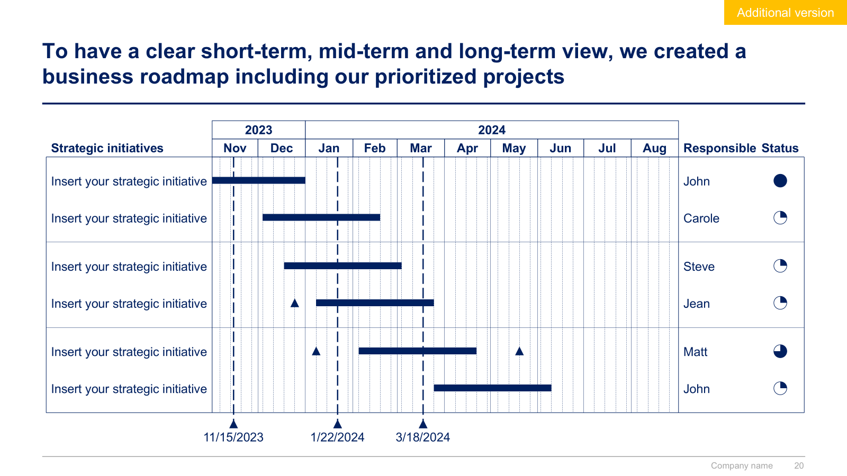
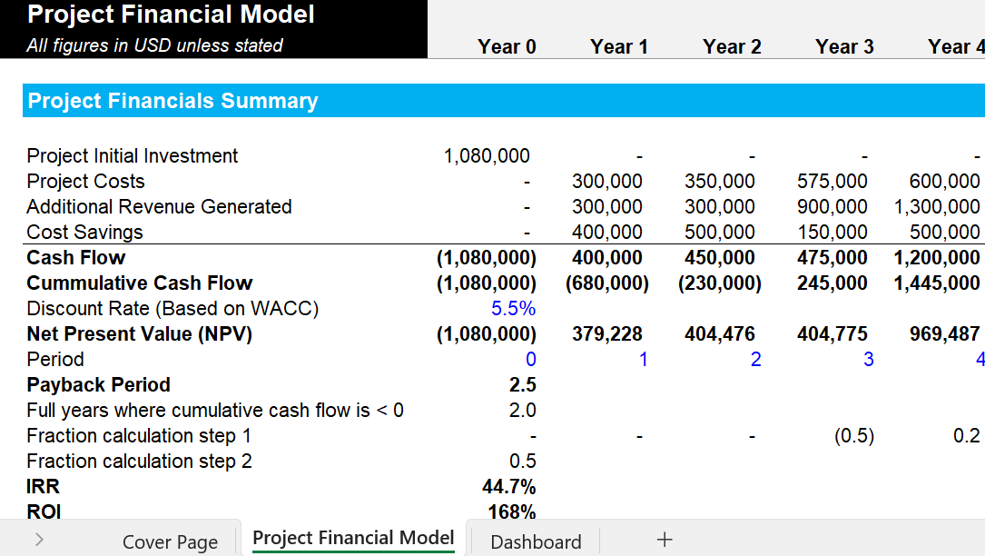
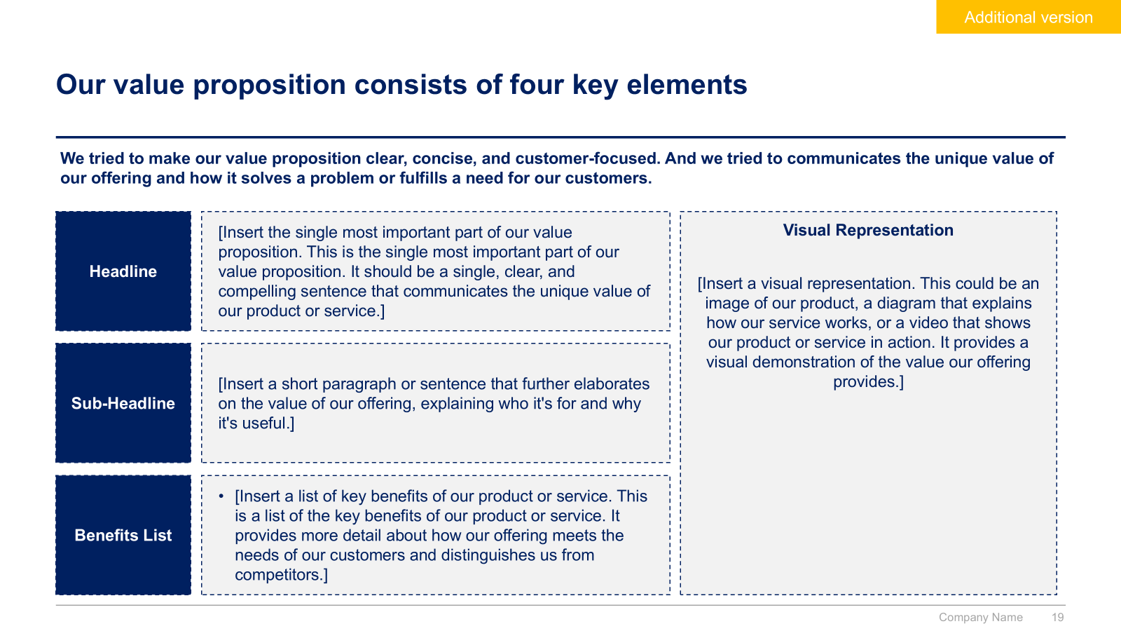
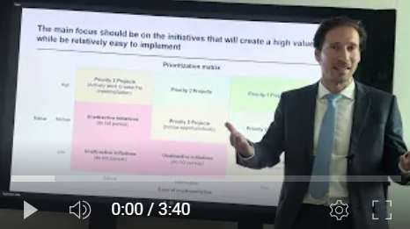
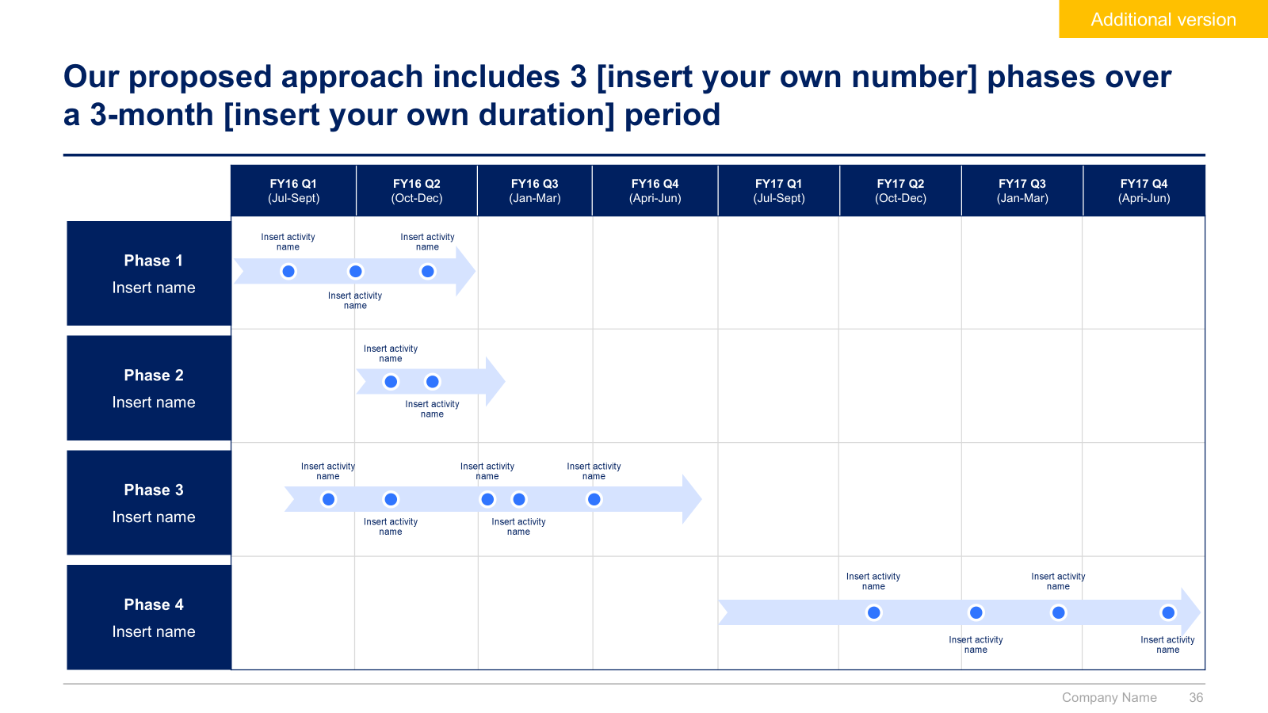
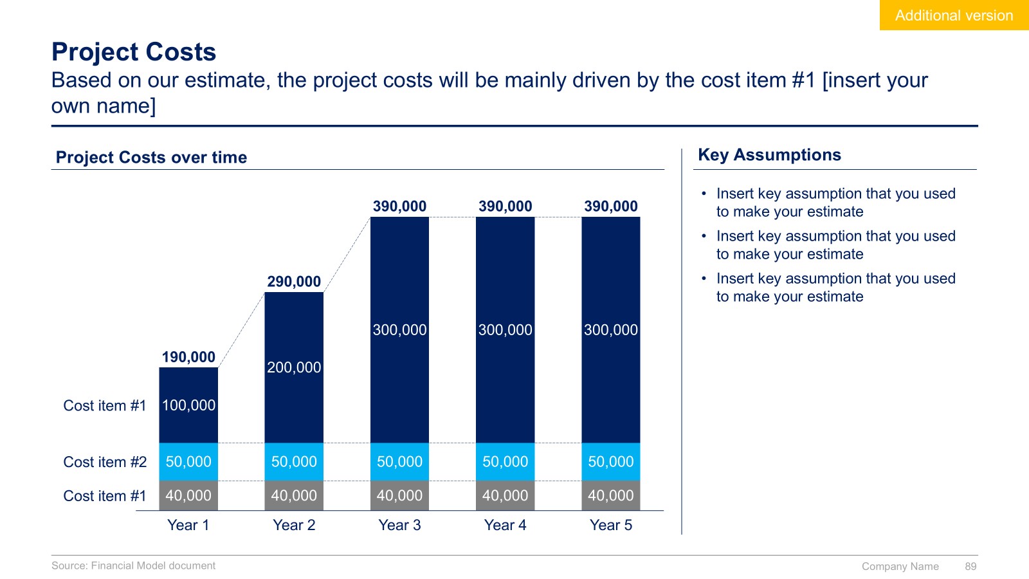
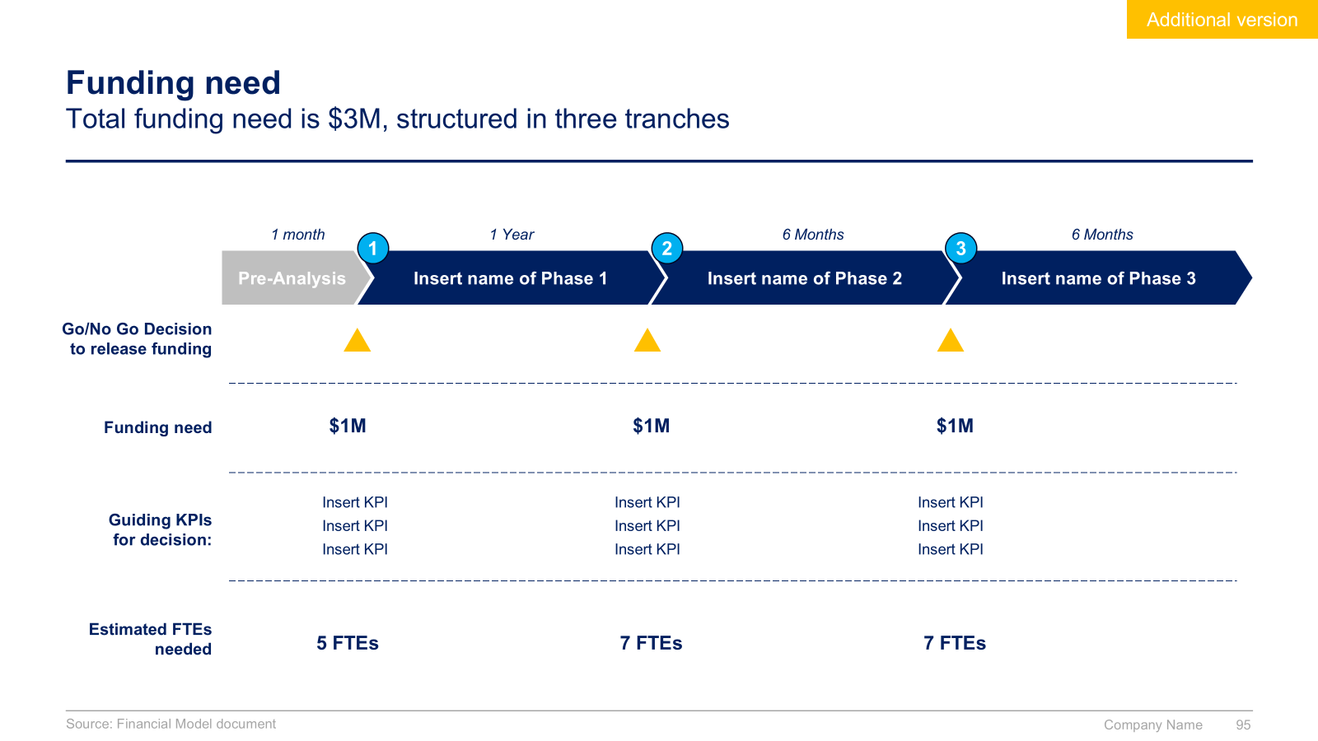
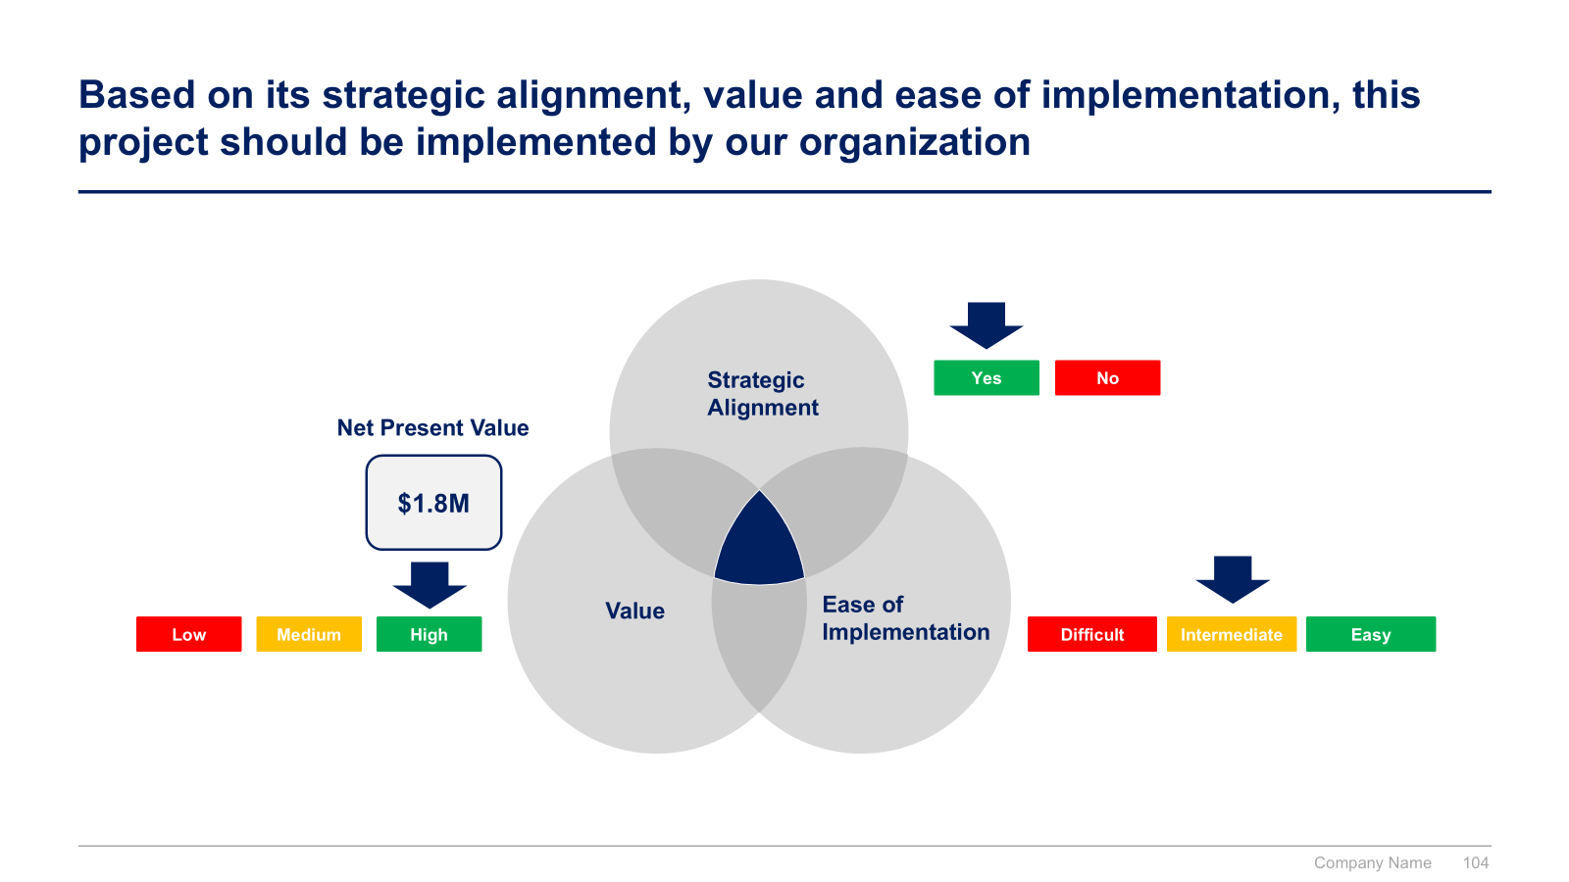

Slide 2


Business Case Toolkit
Overview & Approach

Slide 3


Introduction
This Toolkit was created by ex-McKinsey, Deloitte and BCG Management Consultants, after more than 3000 hours of work. It is considered the world's best & most comprehensive Business Case Toolkit. It includes all the Frameworks, Best Practices & Templates required to assess the strategic alignment, value and feasibility of a project (e.g., New business initiative, new product initiative, business improvement initiative, etc.) and convince the executive committee or board of directors to invest.
Join the 200,000+ Executives, Consultants & Entrepreneurs who are already leveraging our Management Consulting Toolkits to improve the performance of their organization and boost their own career.
If you have any questions, send us an email at support@domontconsulting.com and one of our ex-McKinsey, Deloitte & BCG Management Consultants will get back to you within 2 business days.
Aurelien Domont
Management Consultant
Domont Consulting Managing Director

Slide 4

Problem: Only about 35% of projects meet their original goals and deliver expected business value
Projects’ ability to deliver expected business value¹
Primary causes of failures¹
Unclear Objectives: Vague or poorly defined goals can lead to misalignment and confusion
Inadequate Data: Poor data quality or insufficient analysis can result in flawed decisions
Lack of Stakeholder Engagement: Not involving key stakeholders can mean a lack of support and buy-in
Overly Optimistic Assumptions: Unrealistic expectations about outcomes and timelines can lead to disappointment.
Poor Risk Management: Failing to anticipate and mitigate risks can cause unexpected problems.
Weak Financial Planning: Inaccurate budgeting and financial forecasts can lead to overspending or funding shortfalls.
Strategic Misalignment: Projects that don't align with the company's strategic goals are less likely to succeed.
Success rate
Failure rate
Sources: (1) Harvard Business Review

Slide 5












Solution: Our ex-McKinsey, Deloitte & BCG consultants created a Business Case Toolkit to help you significantly increase your odds of success
What’s inside the Toolkit?
Who created the Toolkit?
The Toolkit was created by former McKinsey, Deloitte & BCG management consultants.
Best Practices
Frameworks
Number of professionals leveraging our Toolkits
Advice from
tier-1 Management Consultants
Tools
There are 200,000+ Executives, Consultants & Entrepreneurs leveraging our Toolkits to improve the performance of their organization
Real-life Examples
Templates
Trusted by small and large organizations
Video Training
Step-by-step Tutorials

Slide 6
Our Toolkit will help you fulfill multiple objectives
The Business Case Toolkit includes frameworks, tools, templates, tutorials, real-life examples, video training, and best practices to help you:
Build a robust Business Case and Financial Model for a project (e.g., New business initiative, new product initiative, business improvement initiative, etc.)
Describe a Project: (1) Situation, Key Challenge and Proposed Solution, (2) Objectives and Key Performance Indicators, (3) Project Scope, Approach and Team, (4) Key Activities and Deliverables, (5) Key Risks and Mitigation Strategies
Assess a Project: (1) Strategic Alignment, (2) Value, (3) Ease of Implementation
Prioritize a Project with a prioritization matrix
Build a robust Financial Model: (1) Assumptions, (2) Project Initial Investment, (3) Project costs, (4) Additional Revenue Generated, (5) Cost Savings, (6) Financial Summary, (7) Dashboard
Convince the Executive Committee or Board of Directors to invest: (1) Present with Impact, (2) PowerPoint Communication Timesaver, (3) Pyramid Principle

Slide 7
The Business Case Toolkit includes a 3-phase approach that we have built and refined over the past 20 years through constant trial and error
Phase 1
Phase 2
Phase 3
Project Description
Project Assessment
Project Prioritization
1
2
3
4
5
1
7
8
9
10
11
12
13
14
15
16
17
18
19
20
21
22
23
24
25
Situation, Key Challenge and Proposed Solution
6
Strategic
Alignment
2
3
4
5
6
7
8
9
10
11
12
13
14
15
16
17
18
19
20
21
22
23
24
2
25
2
3
4
5
2
7
8
9
10
11
12
13
14
15
16
17
18
19
20
21
22
23
24
25
Objectives and Key Performance Indicators
9
3
2
3
4
5
3
7
8
9
10
11
12
13
14
15
16
17
18
19
20
21
22
23
24
25
Project Scope, Approach and Team
4
4
3
4
5
4
7
8
9
10
11
12
13
14
15
16
17
18
19
20
21
22
23
24
25
8
Ease of Implementation
2
3
4
5
8
8
8
9
10
11
12
13
14
15
16
17
18
19
20
21
22
23
24
Key Activities and Deliverables
7
Value
25
2
3
4
5
7
7
8
9
10
11
12
13
14
15
16
17
18
19
20
21
22
23
24
25
5
5
3
4
5
5
7
8
9
10
11
12
13
14
15
16
17
18
19
20
21
22
23
24
25
Key Risks and Mitigation Strategies
Project Financial Model
Project Presentation

Slide 8
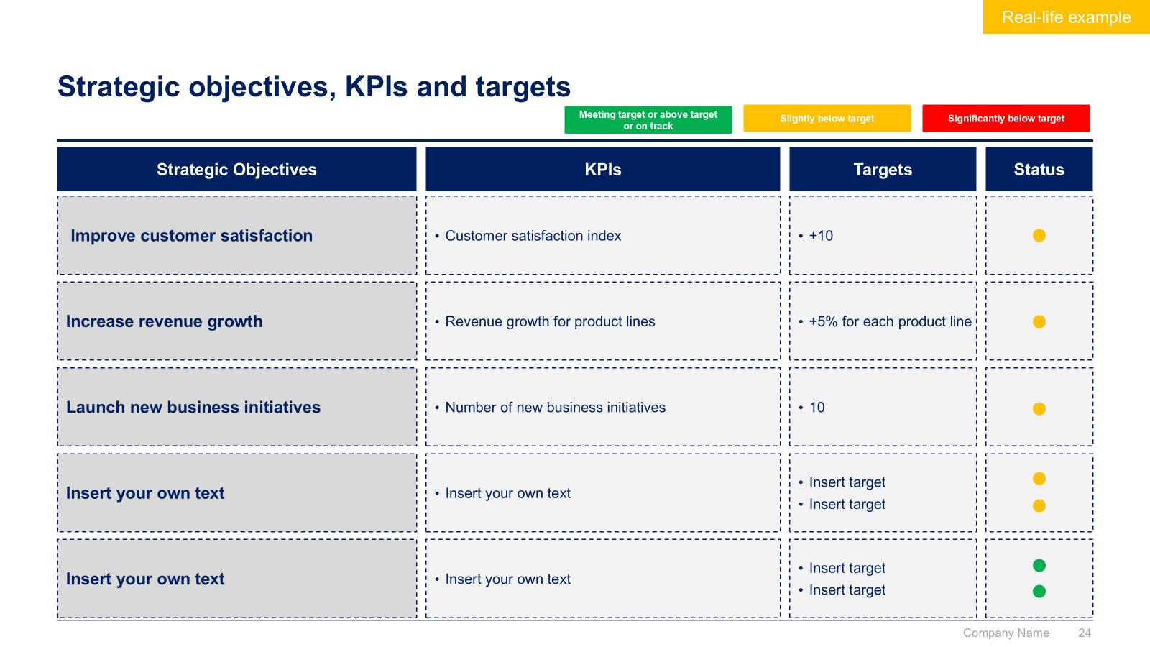
Phase 1 - Small preview
Phase 1
Phase 2
Phase 3
Project Description
Project Assessment
Project Prioritization
Project Financial Model
Project Presentation

Slide 9
Phase 2 - Small preview
Phase 1
Phase 2
Phase 3
Project Description
Project Assessment
Project Prioritization
Project Financial Model
Project Presentation

Slide 10
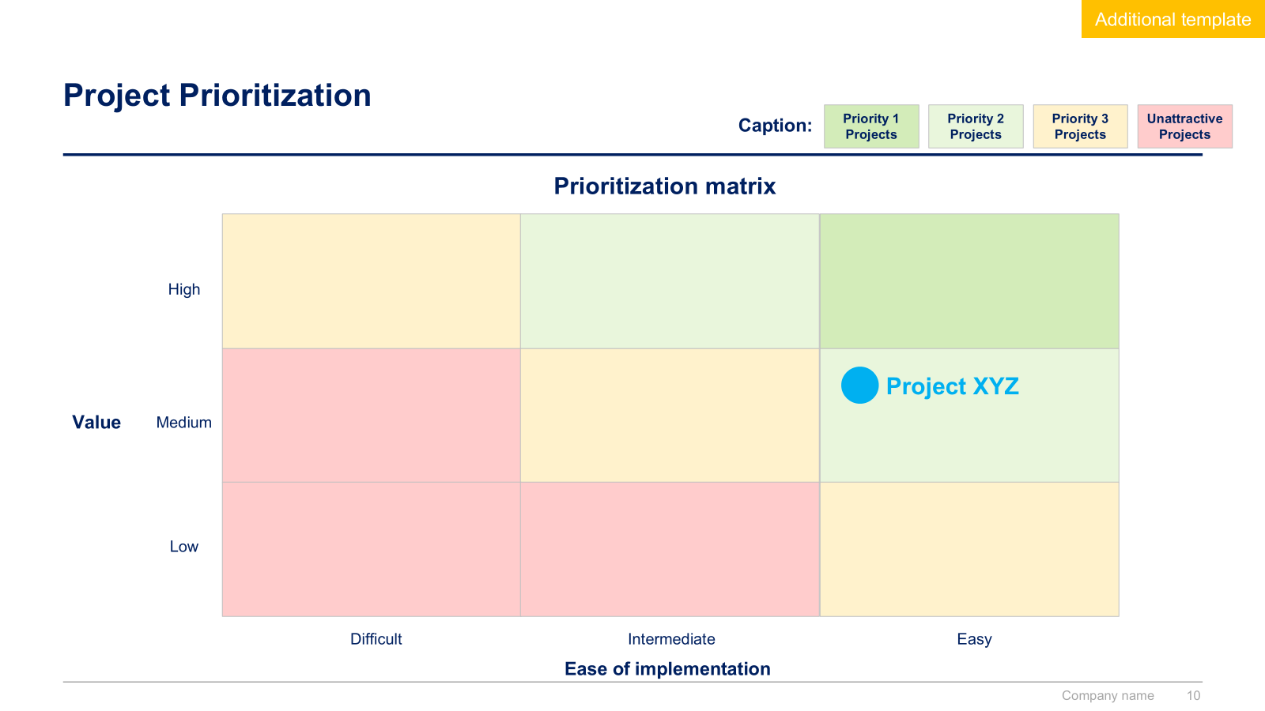
Phase 3 - Small preview
Phase 1
Phase 2
Phase 3
Project Description
Project Assessment
Project Prioritization
Project Financial Model
Project Presentation

Slide 11
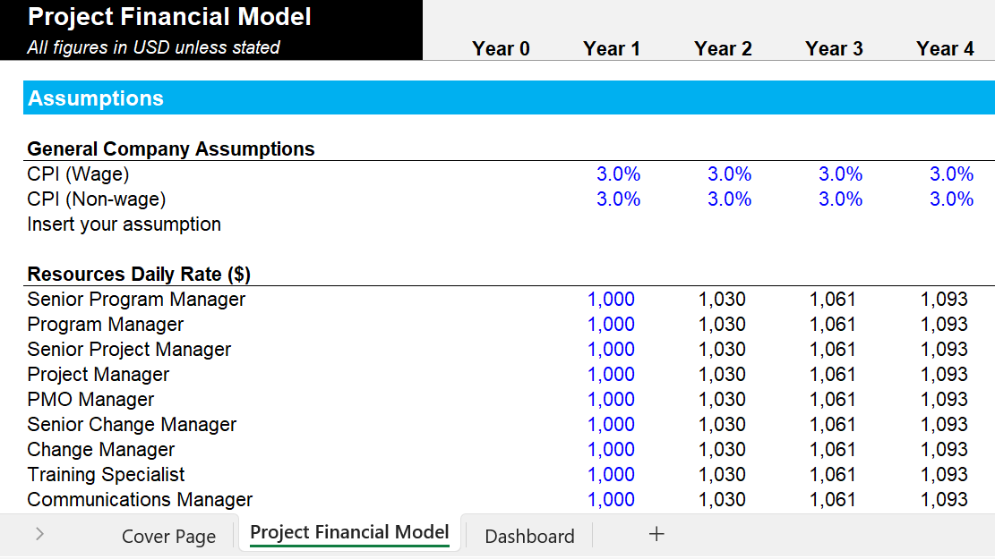
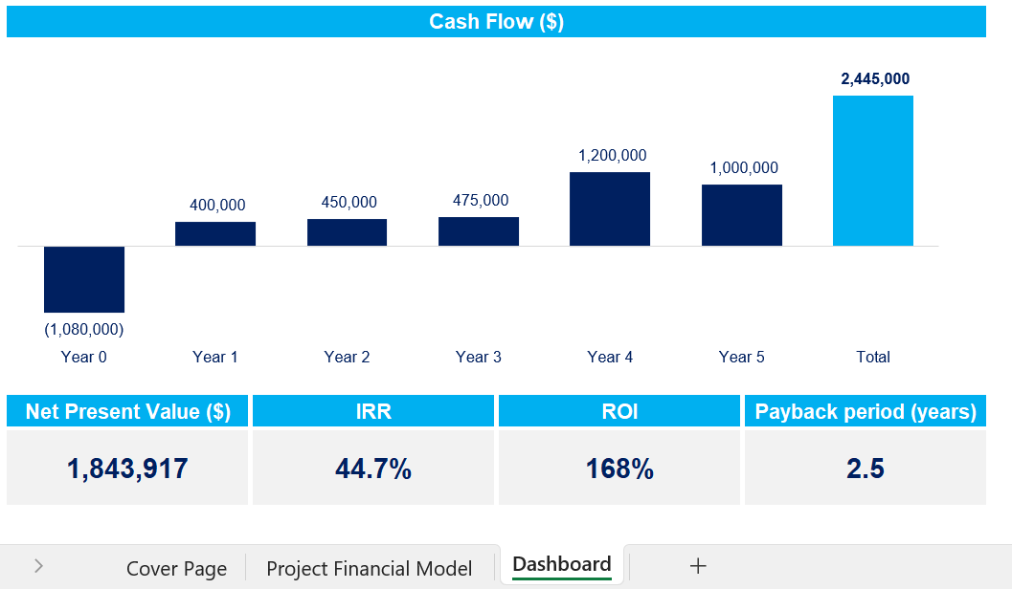
Project Financial Model - Small preview
Phase 1
Phase 2
Phase 3
Project Description
Project Assessment
Project Prioritization
Project Financial Model
Project Presentation

Slide 12
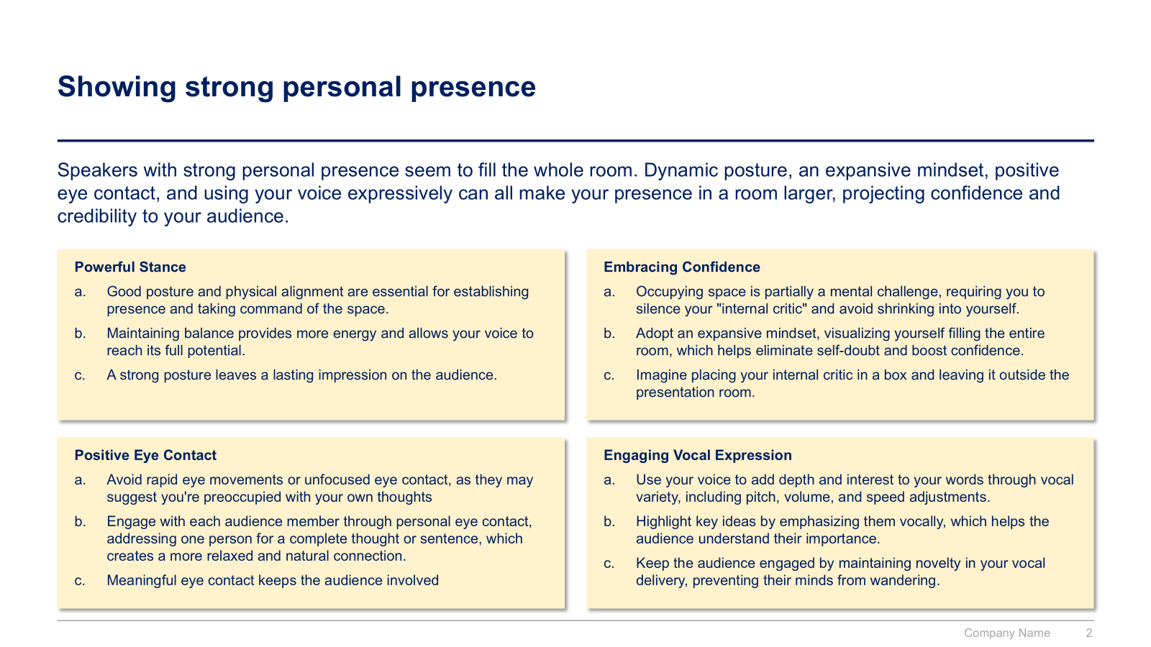
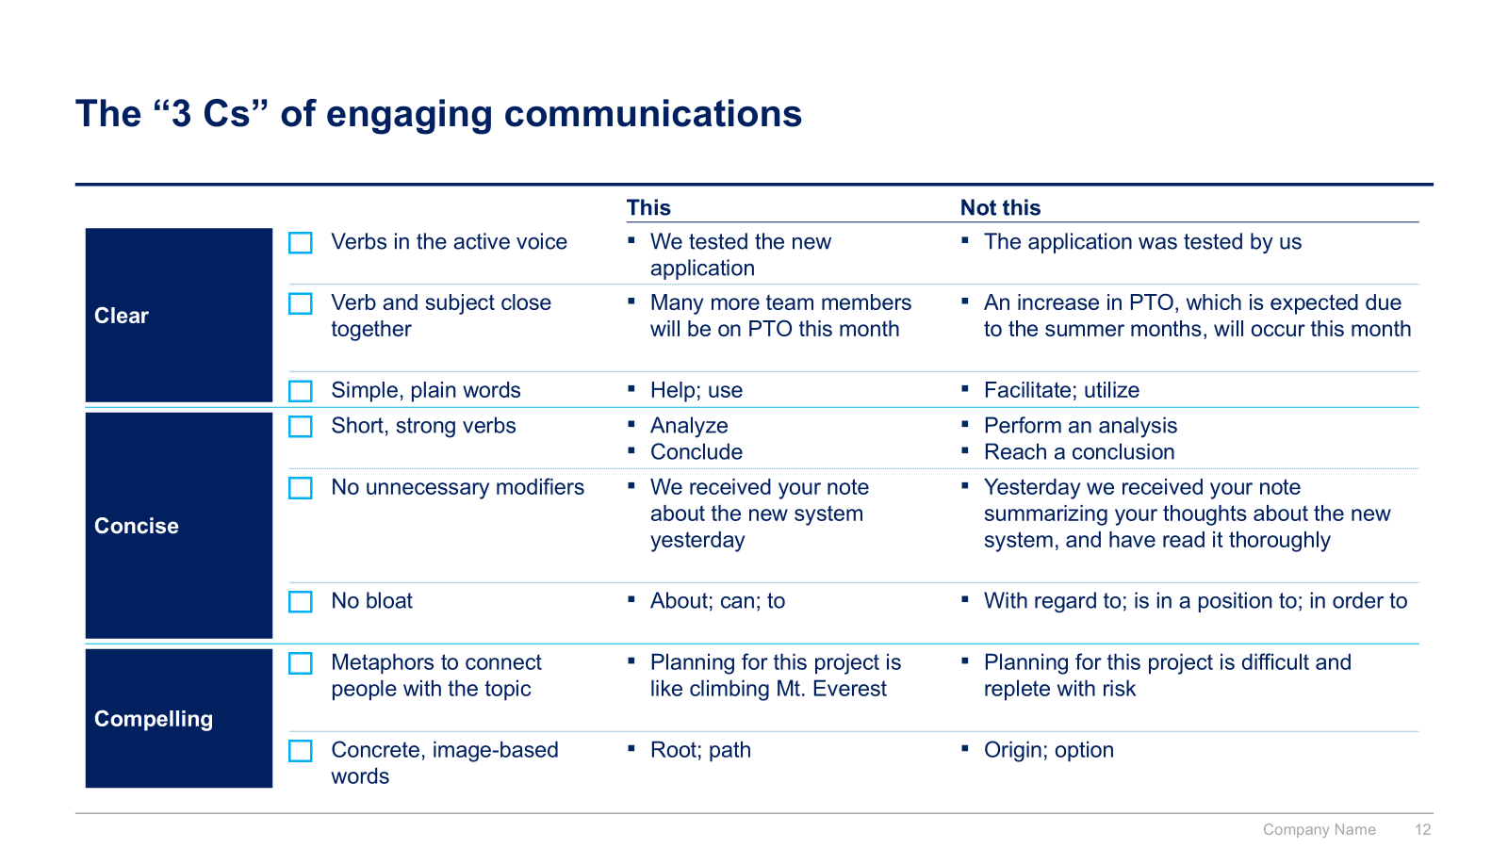
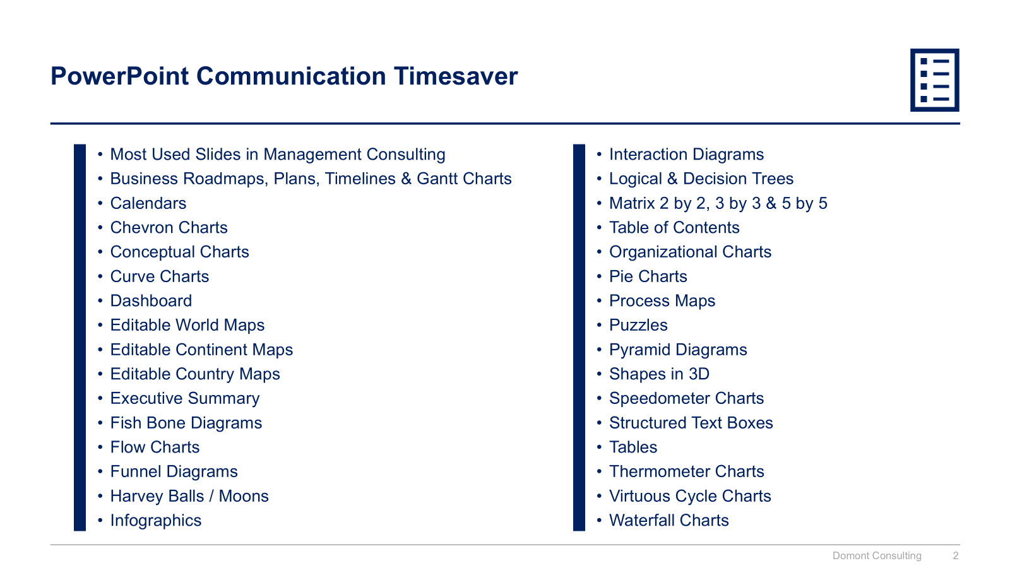
Project Presentation - Small preview
Phase 1
Phase 2
Phase 3
Project Description
Project Assessment
Project Prioritization
Project Financial Model
Project Presentation

Slide 13



The Toolkit includes multiple PowerPoint slides, Excel sheets and Video training that you can download on your device immediately after purchase
400 editable PowerPoint slides*
2 Excel Financial Models
50 minutes of Video training
*Please note that the number of Powerpoint slides listed is the number of unique slides. For example, a Powerpoint slide that has been duplicated to facilitate our clients’ understanding only counts for one slide

Slide 14









Our Management Consulting Toolkits include 9 key benefits
Improve the growth & efficiency of your organization by leveraging Management Consulting Toolkits created by ex-McKinsey, Deloitte & BCG Consultants.
Make a great investment for your career & organization. It cost us US$8M+ over the past 10 years to create all our Toolkits. Get them for a fraction of this cost.
Get a competitive advantage. It’s like hiring Management Consultants to create all the practical Frameworks, Tools & Templates you need.
Get the job done quicker and never start from scratch again with our ready-made and fully editable Frameworks, Tools & Templates in Powerpoint & Excel.
Don't reinvent the wheel. We have already worked 30,000+ hours over the past 10 years to create all the Management Consulting Toolkits you need.
Improve the capabilities of your organization by learning how the Fortune 100 and Global Consulting Firms do it.
Decrease your costs. Hiring tier-1 Consultants for a project would cost you $300k+. Way more expensive than our Toolkits, which will last you a lifetime!
Become your organization’s subject matter expert and impress your stakeholders with world-class approaches to resolve common business problems.
Get free support and advice from our ex-McKinsey, Deloitte & BCG Management Consultants.

Slide 15
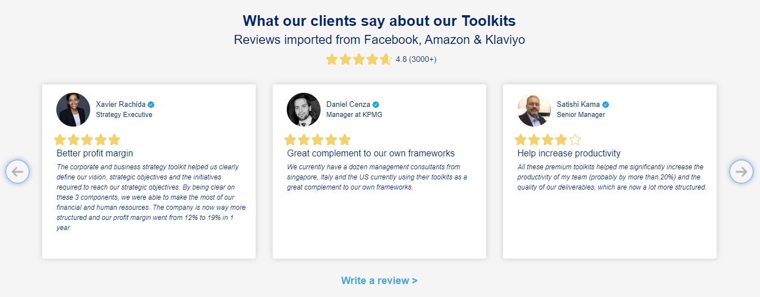
What our clients say about our Toolkits
Click here to see more reviews >

Slide 16

Join 200,000+ Executives, Consultants & Entrepreneurs leveraging our Toolkits to improve the performance of their organization
Trusted by small and large organizations
Customer satisfaction
4.8
Number of countries leveraging our Toolkits
160+
Number of professionals leveraging our Toolkits
200,000+
Daily rate of our ex-McKinsey, Deloitte and BCG Management Consultants
$3k-$4k

Slide 17

Interested in more than 1 Toolkit? Access all our Toolkits for half the price with our Gold Access
Gold Access
Click here to learn more

Slide 18
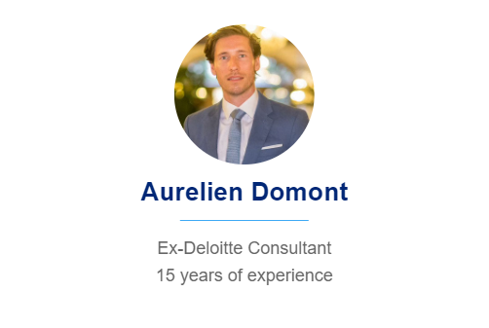
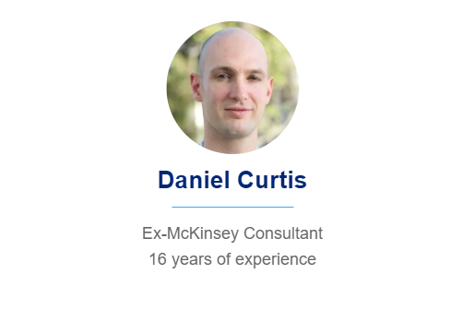
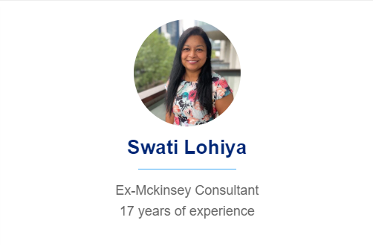

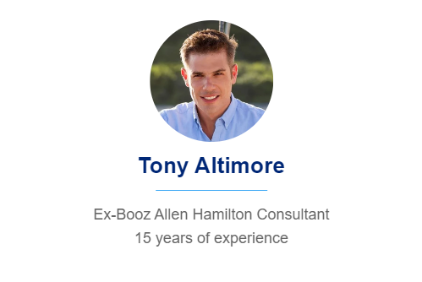
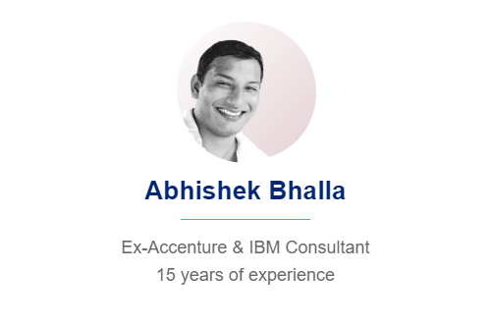
Need additional help? Send us a brief and we’ll find you the right talent from our network of 500+ tier-1 Management Consultants
Click here to send us a Project Brief

Slide 19

This was just a small preview.
www.domontconsulting.com

